Slide 1


ML.NET in the Real World
Bri Achtman
Kundan Karma
Chris Felstead
Brett Parker

Slide 2
What is Machine Learning?
Artificial Intelligence
Machine Learning
Getting computers to make predictions without being explicitly programmed
Artificial Intelligence
The ability of a computer to perform tasks commonly associated with intelligent beings (reason, discover meaning, generalize, learn from past experience)
Deep Learning
Subset of ML based on artificial neural networks which imitate the way the human brain learns, thinks, and processes data.
Machine Learning
Deep
Learning
Notes:
AI = machines imitating human abilities and behaviors
Typically starts as rule or logic-based system
Traditional AI techniques can be difficult to scale
ML
Computers find patterns in data and learn from experience to act on new data
Used to solve problems that are difficult or impossible to solve with rules-based programming
Deep learning
Neural networks form many layers
Scenarios include image classification, object detection, speech recognition, NLP
AI: Rules + Data = Answers
Data + Answers = Rules

Slide 3







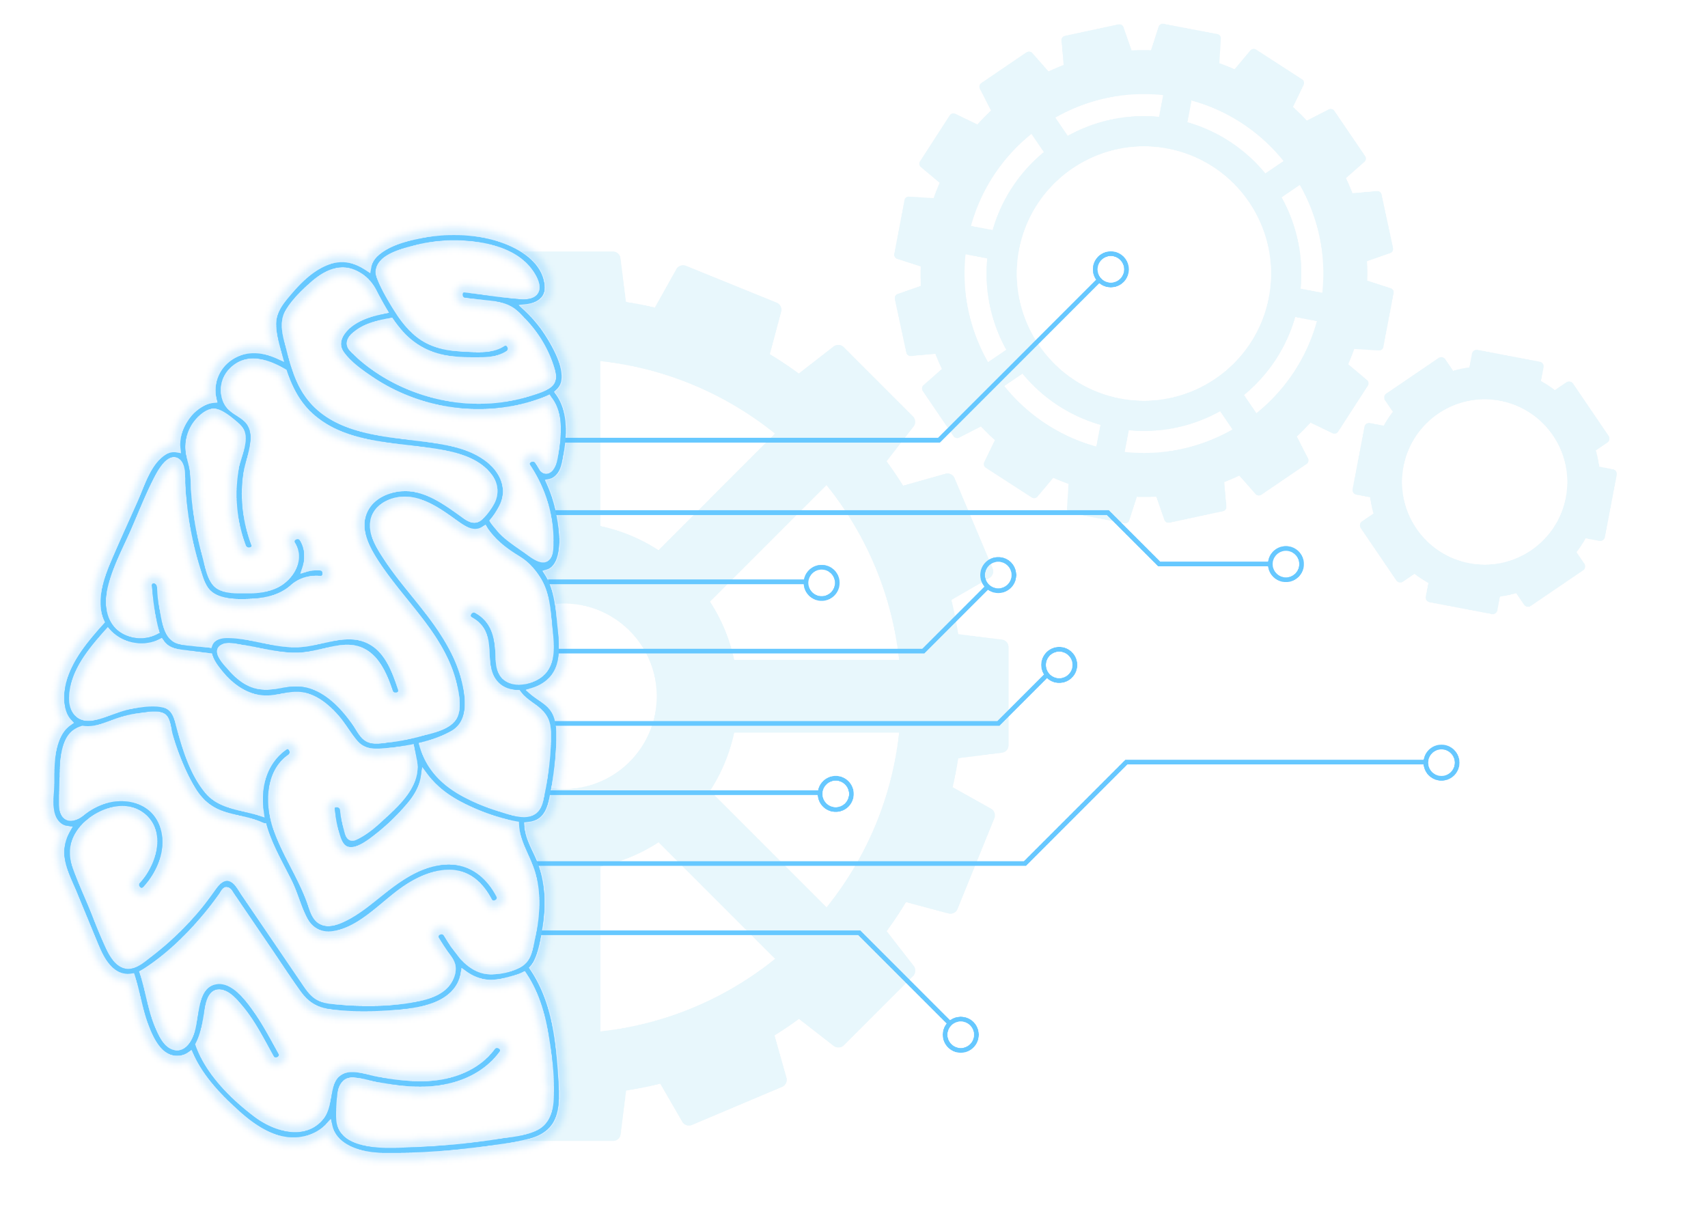

Machine Learning Landscape
External
At Microsoft
Azure Cognitive Services
Azure Machine Learning
WinML
 | Training custom models | Model consumption | Requires ML knowledge
ML.NET | Yes | Yes - ML.NET, TensorFlow, ONNX | No
Azure Cognitive Services | Limited to some services | Yes – consume via API/SDK | No
Azure ML | Yes | Yes – register models & consume via web service | Somewhat
WinML | No | Yes - ONNX | No
Notes:
scikit-learn – Traditional / Classical Machine Learning
TensorFlow – ML Deep Learning
PyTorch – ML Deep Learning
Keras – Open-source library that provides a Python interface for artificial neural networks. Higher level API for building ML that can use a variety of back-ends to actually build the models and computations; Keras acts as an interface for the TensorFlow library.
ONNX - An open format built to represent machine learning models allowing you to interchange models between various ML frameworks and tools

Slide 4

What is ML.NET?
An open source and cross-platform machine learning framework for .NET
Windows
Linux
macOS
Notes:
History:
2002: MSR begins TMSN (“text mining search and navigation”) to enable internal devs to easily add custom ML to Microsoft products and technologies
2011: Library renamed to The Learning Code (TLC); widely used within Microsoft
2018: TLC is made open source, cross-platform, and released as ML.NET in first public preview at Build 2018
2019: ML.NET GA release at Build 2019
2020: Virtual ML.NET – first all ML.NET conference!

Slide 5
Built for
.NET
Developers
Can use existing C# and F# skills to integrate ML into .NET apps
Data science & ML experience not required

Slide 6
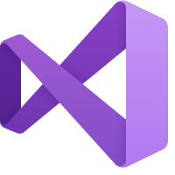
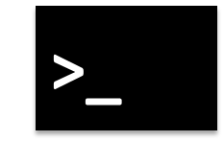
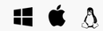


ML.NET + AutoML + Tooling
Model Builder
ML.NET CLI
AutoML.NET API
(Microsoft.ML.AutoML)
ML.NET API
(Microsoft.ML)

Slide 7
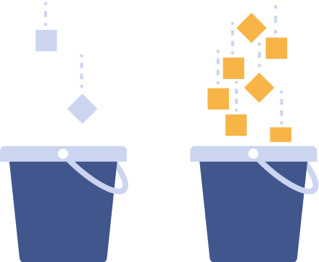
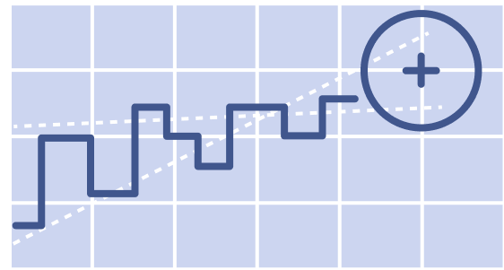

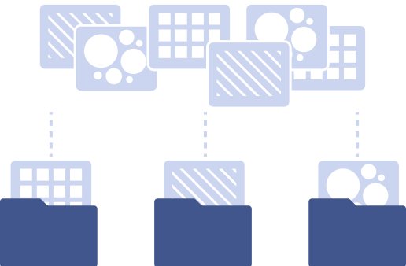





What can you do with ML.NET?
Classification
Regression
Forecasting
Anomaly detection
Image classification
Ranking
Clustering
Recommendation
Object detection
Notes:
Classification – Sentiment analysis, Categorizing e-mail as spam or not spam, Classify law documents
Regression – Price prediction, Predict sales of product based on advertising budgets
Forecasting - Predicting future sales based on past sales, Predictive maintenance, Weather forecasting
Anomaly detection – Identifying potentially fraudulent transactions, detecting network intrusions
Ranking – Search results ranking
Clustering – Customer segmentation
Recommendation – Product Recommendation

Slide 8
When should you use ML.NET?
When you…
Want to stay in .NET ecosystem for Machine Learning
Don’t want to worry about low-level complexities of ML
Want to train a custom model
Want to consume a pre-trained model

Slide 9
Roadmap
Nov 2020
Dec 2020
Early 2021
All Azure-supported scenarios in Model Builder
Local forecasting, anomaly detection, object detection in Model Builder
Re-open state in Model Builder
Azure ML Datasets support
Advanced data loading options in Model Builder
ML.NET Hackathon (Nov 13)
Open-source tooling
Ongoing
MLOps Integration
Model explainability
Adding all ML.NET scenarios to tooling – local + Azure
ML.NET runs everywhere .NET runs, including Blazor WASM, mobile, IoT

Slide 10
Resources
Twitter
@briacht
@kundankarma
@TechLeadKit
@FuturesSport
@_Brett_Parker
@AVEVAGroup
Get started at http://dot.net/ml
Try the samples at http://aka.ms/mlnetsamples
Read the docs at http://aka.ms/mlnetdocs
Watch ML.NET videos at https://aka.ms/mlnetyoutube
Request features or contribute at http://aka.ms/mlnet
Take the workshop at http://aka.ms/mlnet-workshop
ML.NET Hackathon
Friday Nov 13
aka.ms/mlnet-hack

Slide 11
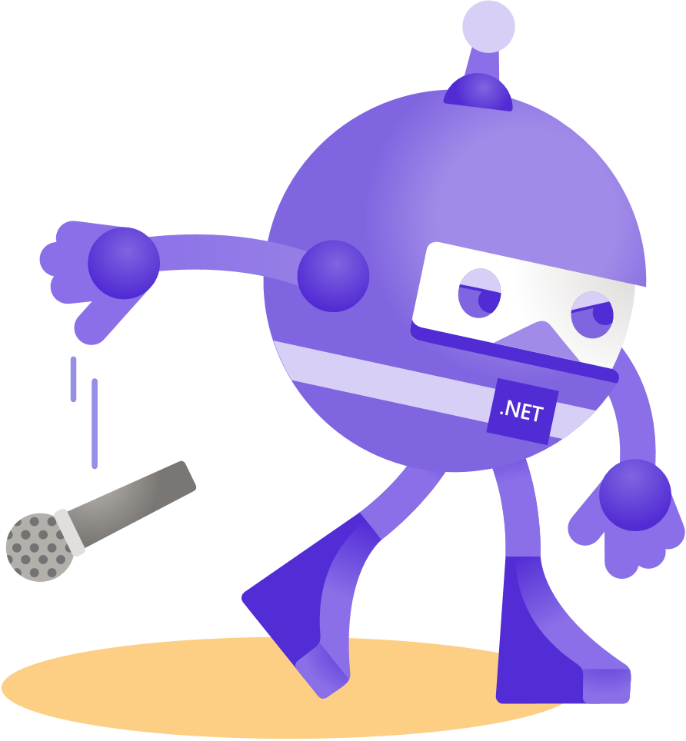
Thanks for joining!

